Slide 1
Zero-shot Learning
Dr. Yan Yan

Slide 2
Transfer Learning - Overview
Source Data (not directly related to the task)
labelled
unlabeled
Fine-tuning
labelled
Multitask Learning
Target Data
Domain-adversarial training
unlabeled
Zero-shot learning

Slide 3
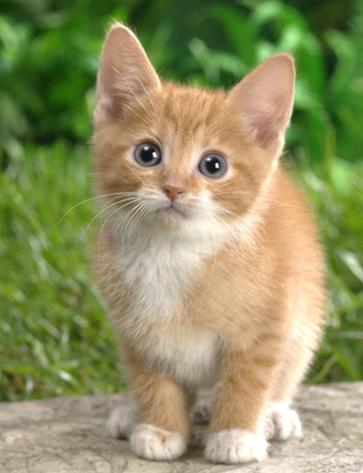
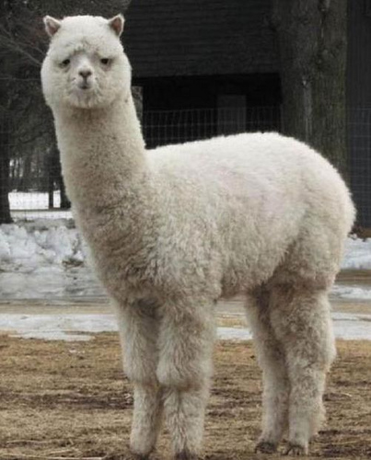
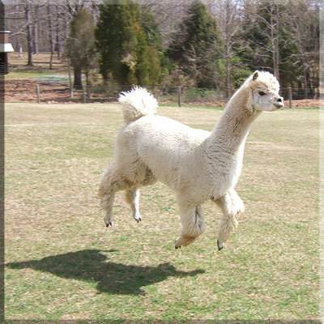
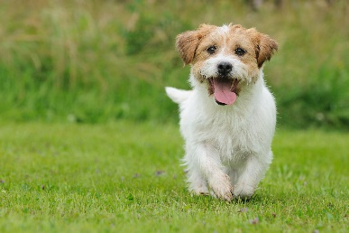




Zero-shot Learning
http://evchk.wikia.com/wiki/%E8%8D%89%E6%B3%A5%E9%A6%AC
Training data
Source data: $\left(x^{s},y^{s}\right)$
Target data: $\left(x^{t}\right)$
Different tasks
Testing data
$x^{s}$:
……
$x^{t}$:
$y^{s}$:
cat
dog
……

Slide 4
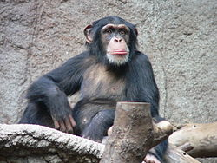
Zero-shot Learning
Representing each class by its attributes
Database
Training
attributes
1
0
0
1
1
1
 | furry | 4 legs | tail | …
Dog | O | O | O
Fish | X | X | O
Chimp | O | X | X
…
furry
4 legs
tail
furry
4 legs
tail
NN
NN
class
sufficient attributes for one to one mapping

Slide 5
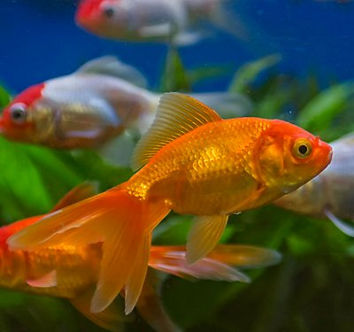
Zero-shot Learning
Representing each class by its attributes
Find the class with the most similar attributes
Testing
attributes
0
0
1
 | furry | 4 legs | tail | …
Dog | O | O | O
Fish | X | X | O
Chimp | O | X | X
…
furry
4 legs
tail
NN
class
sufficient attributes for one to one mapping

Slide 6
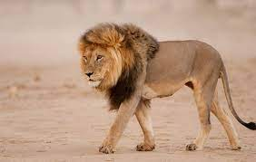
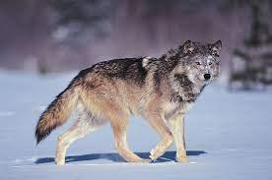
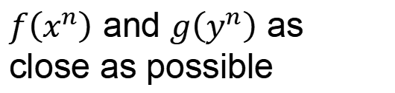







Zero-shot Learning
$f\left(∗\right)$ and $g\left(∗\right)$ can be NN.
Attribute embedding
Training target:
$f\left(x^{n}\right)$ and $g\left(y^{n}\right)$ as close as possible
x²
y¹ (attribute of chimp)
y² (attribute of dog)
x¹
$$f\left(x^{2}\right)$$
$$g\left(y^{2}\right)$$
$$f\left(x^{1}\right)$$
$$g\left(y^{1}\right)$$
y³ (attribute of Grass-mud horse)
$$g\left(y^{3}\right)$$
$$f\left(x^{3}\right)$$
x³
Embedding Space

Slide 7

Zero-shot Learning
Attribute embedding + word embedding
What if we don’t have database
y¹ (attribute of chimp)
x²
V(chimp)
y² (attribute of dog)
V(dog)
x¹
$$f\left(x^{2}\right)$$
$$g\left(y^{2}\right)$$
$$f\left(x^{1}\right)$$
$$g\left(y^{1}\right)$$
$$g\left(y^{3}\right)$$
$$f\left(x^{3}\right)$$
V(Grass-mud_horse)
x³
y³ (attribute of Grass-mud horse)
Embedding Space

Slide 8

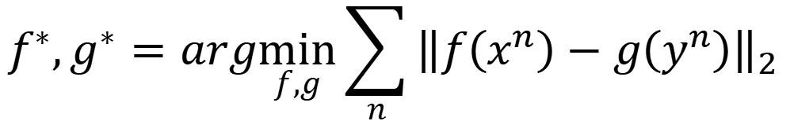
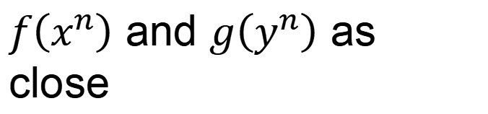
Zero-shot Learning
$$f^{∗},g^{∗}=arg\min_{f,g}{\sum_{n}{{\left\|f\left(x^{n}\right)−g\left(y^{n}\right)\right\|}_{2}}}$$
Problem?
$$f^{∗},g^{∗}=arg\min_{f,g}{\sum_{n}{max\left(0,k−f\left(x^{n}\right)∙g\left(y^{n}\right)+\max_{m≠n}{f\left(x^{m}\right)∙g\left(x^{m}\right)}\right)}}$$
Margin you defined
Zero loss:
$$k−f\left(x^{n}\right)∙g\left(y^{n}\right)+\max_{m≠n}{f\left(x^{n}\right)∙g\left(y^{m}\right)}<0$$
$$f\left(x^{n}\right)∙g\left(y^{n}\right)−\max_{m≠n}{f\left(x^{n}\right)∙g\left(y^{m}\right)}>k$$
$f\left(x^{n}\right)$ and $g\left(y^{n}\right)$ as close
$f\left(x^{n}\right)$ and $g\left(y^{m}\right)$ not as close

Slide 9
Zero-shot Learning
Convex Combination of Semantic Embedding
lion
tiger
V(tiger)
0.5
0.5
Find the closest word vector
V(liger)
NN
0.5V(tiger)+0.5V(lion)
V(lion)
Only need off-the-shelf NN for ImageNet and word vector

Slide 10
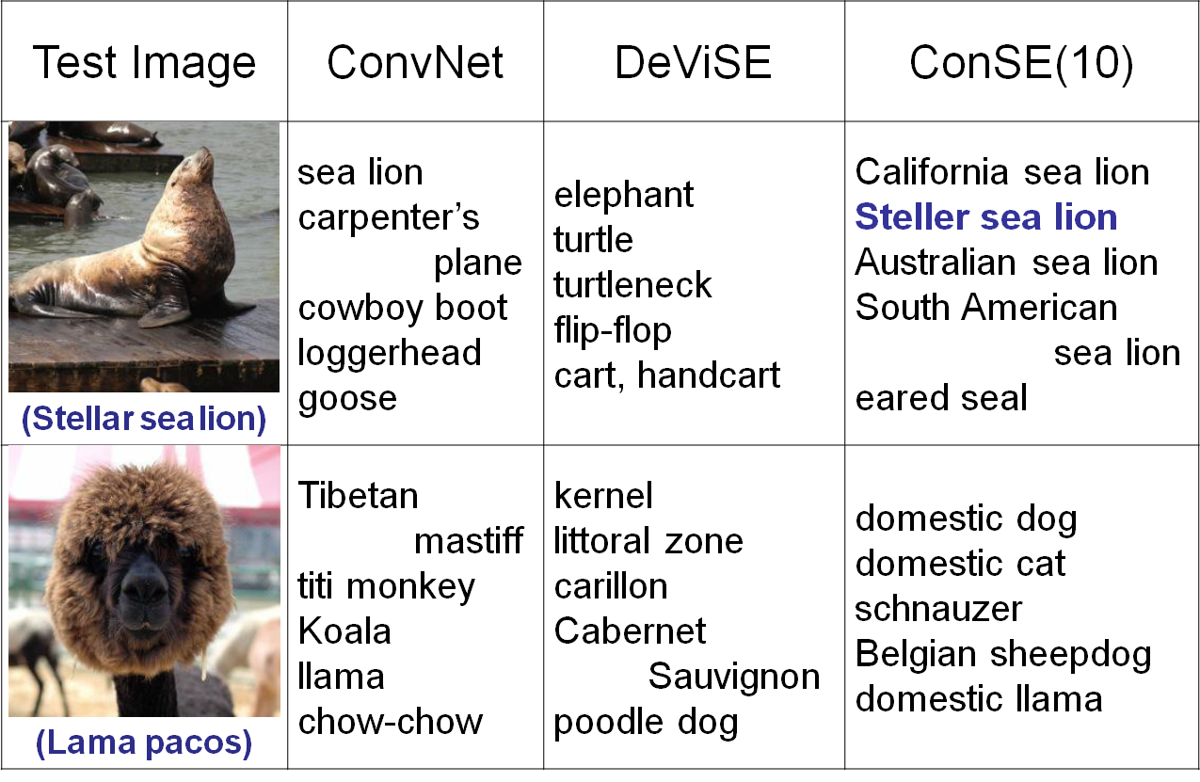
https://arxiv.org/pdf/1312.5650v3.pdf

Slide 11
Example of Zero-shot Learning
Melvin Johnson, Mike Schuster, Quoc V. Le, Maxim Krikun, Yonghui Wu, Zhifeng Chen, Nikhil Thorat. Google’s Multilingual Neural Machine Translation System: Enabling Zero-Shot Translation, arXiv preprint 2016

Slide 12
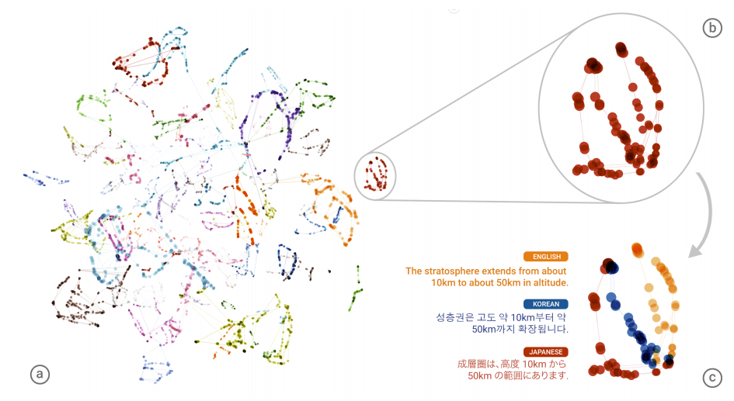
Example of Zero-shot Learning

Slide 13
Transfer Learning - Overview
Source Data (not directly related to the task)
labelled
unlabeled
Self-taught learning
Fine-tuning
labelled
Rajat Raina , Alexis Battle , Honglak Lee , Benjamin Packer , Andrew Y. Ng, Self-taught learning: transfer learning from unlabeled data, ICML, 2007
Multitask Learning
Different from semi-supervised learning
Target Data
Domain-adversarial training
unlabeled
Self-taught Clustering
Zero-shot learning
Wenyuan Dai, Qiang Yang, Gui-Rong Xue, Yong Yu, "Self-taught clustering", ICML 2008

Slide 14
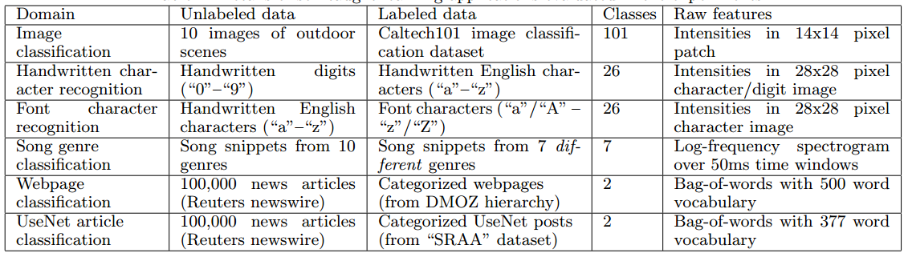
Self-taught learning
Learning to extract better representation from the source data (unsupervised approach)
Extracting better representation for target data

